Slide 1
BOOKNEST-A PLATFORM TO REVIEW BOOKS
BY BATCH-06

Slide 2

TEAM MEMBERS:-
221FA04286:-B.AJAY HARI KRISHNA
221FA04179:-V.PRUDHVI KRISHNA
221FA04069:-K.SUBHASH
221FA04078:-Y.AJAY KUMAR

Slide 3

ABSTRACT:-
BookNest is a comprehensive web-based book review platform that enables users to discover, review, and manage their reading experiences. The platform features dual user roles (admin and user), real-time interaction capabilities, and a modern responsive interface built with React and TypeScript.
To ensure the authenticity of reviews, the app requires users to answer a verification questionnaire before posting a review. The admin creates 10 questions for each book, and users must answer 3 randomly selected questions correctly to post their review. This process helps maintain the integrity of the reviews on the platform.

Slide 4
INTRODUCTION:
Project Background
BookNest addresses the need for a centralized platform where readers can:
Discover and review books
Maintain personal reading lists
Share their reading experiences
Verify their reading comprehension
Interact with other readers
The platform also provides administrators with tools to manage content and monitor user activity.

Slide 5
Literature Survey
Modern web development technologies used:
React with TypeScript for frontend
Express.js for backend API
MongoDB for data persistence
Tailwind CSS for styling
Shadcn UI components for interface elements
React Query for state management

Slide 6
Objectives of the Project
Create a user-friendly book review platform
Implement secure user authentication
Enable book management and review systems
Provide administrative control features
Ensure responsive and accessible design

Slide 7
Project Description:
BookNest is a full-stack web application designed to serve as a centralized platform for book lovers to discover, review, and manage their reading activities. The system supports two primary user roles: users, who can explore and review books, and admins, who oversee platform content and user interactions.
The frontend is developed using React with TypeScript, providing a dynamic, type-safe, and interactive user experience. The UI is styled with Tailwind CSS and enhanced with Shadcn UI components to ensure a clean and responsive interface. React Query is utilized for efficient state and data-fetching management, ensuring seamless user interactions.
The backend is built with Express.js, providing robust APIs, while MongoDB serves as the NoSQL database for storing user data, book details, and reviews. Secure user authentication mechanisms are implemented to ensure safe access and interaction

Slide 8
Software Requirements Specification
Requirement Analysis
The system needs to support:
User authentication and authorization
Book catalog management
Review and rating system
Reading list management
User activity tracking
Administrative controls

Slide 9
Project Statement:
Many existing book platforms fall short in providing a holistic and engaging user experience. They often lack mechanisms to verify whether users have actually read the books they review, leading to credibility issues. Additionally, these platforms typically do not offer modern, responsive interfaces that cater to the needs of today’s users across various devices. There is also a noticeable absence of robust administrative controls, making it difficult to manage content and user activity effectively. Furthermore, integrated tools that allow users to manage their reading lists and track their progress are either limited or completely missing.

Slide 10
Functional Requirements
User Management
Registration and authentication
Role-based access control
Profile management
Book Management
CRUD operations for books
Categorization and search
Cover image handling
Review System
Rating and commenting
Review management
Reading verification
Reading Lists
Personal reading lists
Liked books collection
Progress tracking

Slide 11
Non Functional Requirements
Performance:
Fast page load times Responsive interface Efficient data queries Security:
Secure authentication Protected API endpoints Session management
Scalability:
Modular architecture Efficient database design Stateless API design

Slide 12
Software and Hardware Specifications
Software Requirements:
Node.js 20+
MongoDB
Modern web browser
npm/yarn package manager
Hardware Requirements: 2GB RAM minimum
1GB storage space
Internet connectivity

Slide 13
External Interface Requirements:
Here are some additional external interface requirements tailored to the BookNest project:
JWT-based authentication interface for secure user login and role-based access control
Email service integration for account verification, password resets, and notifications
Search API interface for querying books, reviews, and users efficiently
Third-party book data integration (optional) to auto-fetch book details (e.g., from Google Books API)
Comment and interaction API for enabling user engagement on reviews
Responsive frontend interface to interact with backend APIs using React Query
Admin dashboard interface for content moderation, analytics, and user management
Rating and review system interface for users to submit and manage book feedback
Real-time notifications interface (optional) using WebSockets or polling for live updates on user interactions
Accessibility features interface to support screen readers and keyboard navigation

Slide 14
Feasibility Study:
The project is feasible due to:
Available open-source technologies
Scalable architecture
Modern development stack
Clear user requirements
Manageable scope

Slide 15
Analysis & Design:
System Overview : BookNest follows a client-server architecture with:
React frontend Express.js backend MongoDB database RESTful API communication
System Architecture
Three-tier architecture:
Presentation Layer (React)
Application Layer (Express.js)
Data Layer (MongoDB)

Slide 16
Data design:
MongoDB Collections:
Users Books Reviews ReadingLists LikedBooks VerificationQuestions

Slide 17
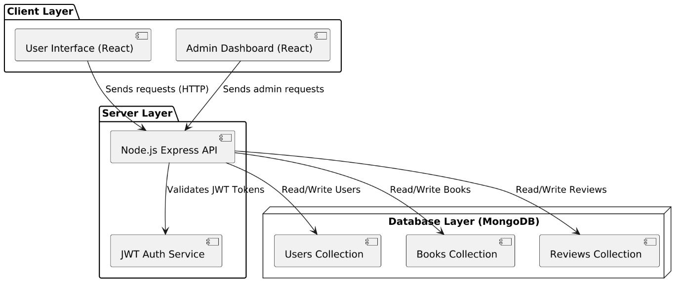
modeling:
Web Application Architecture Diagram:-

Slide 18
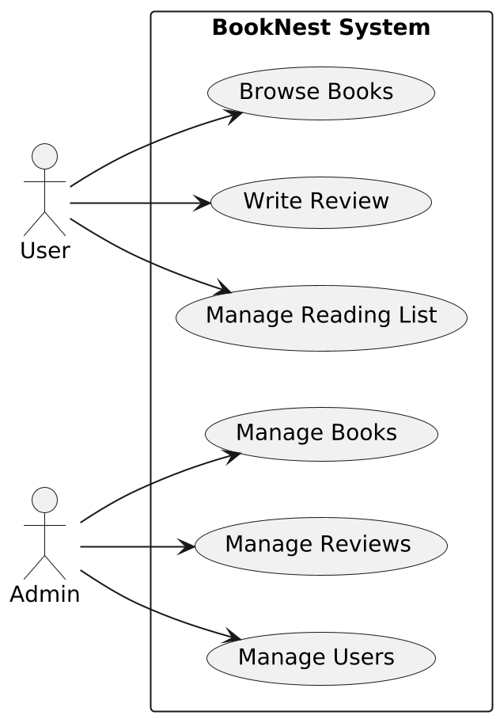
modeling:
Use Case Diagram

Slide 19
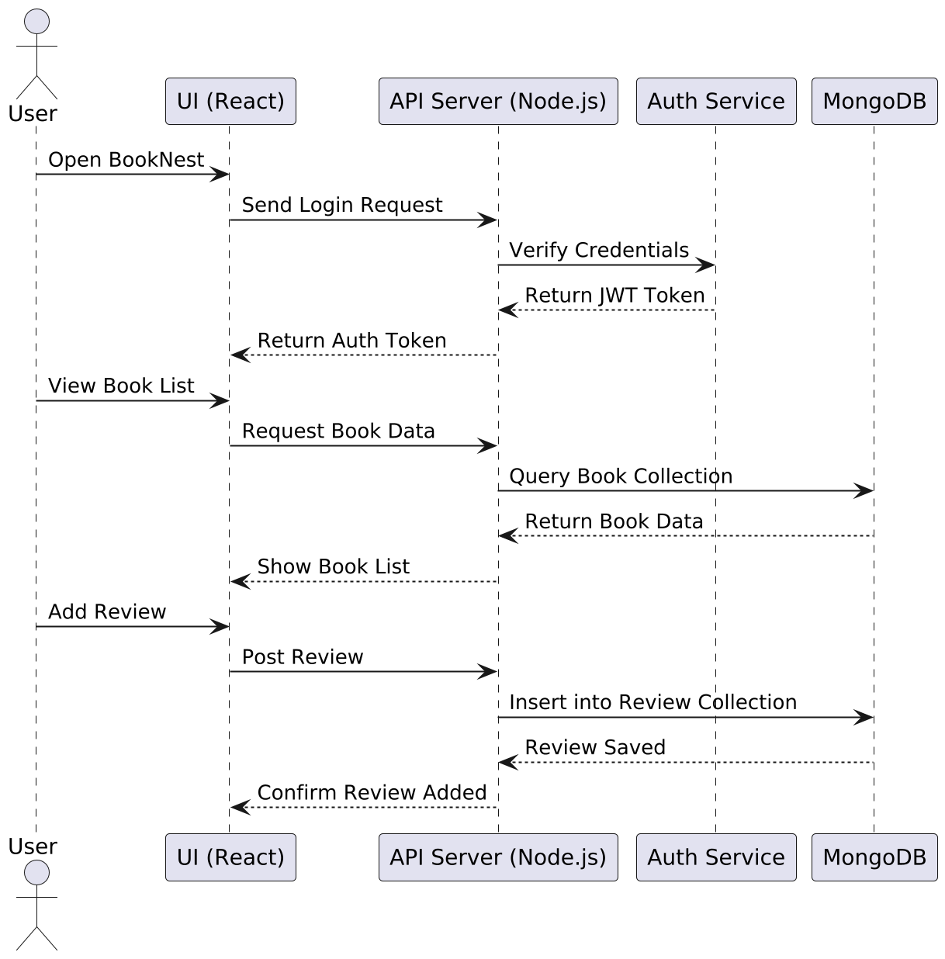
modeling:
Sequence diagram:-

Slide 20
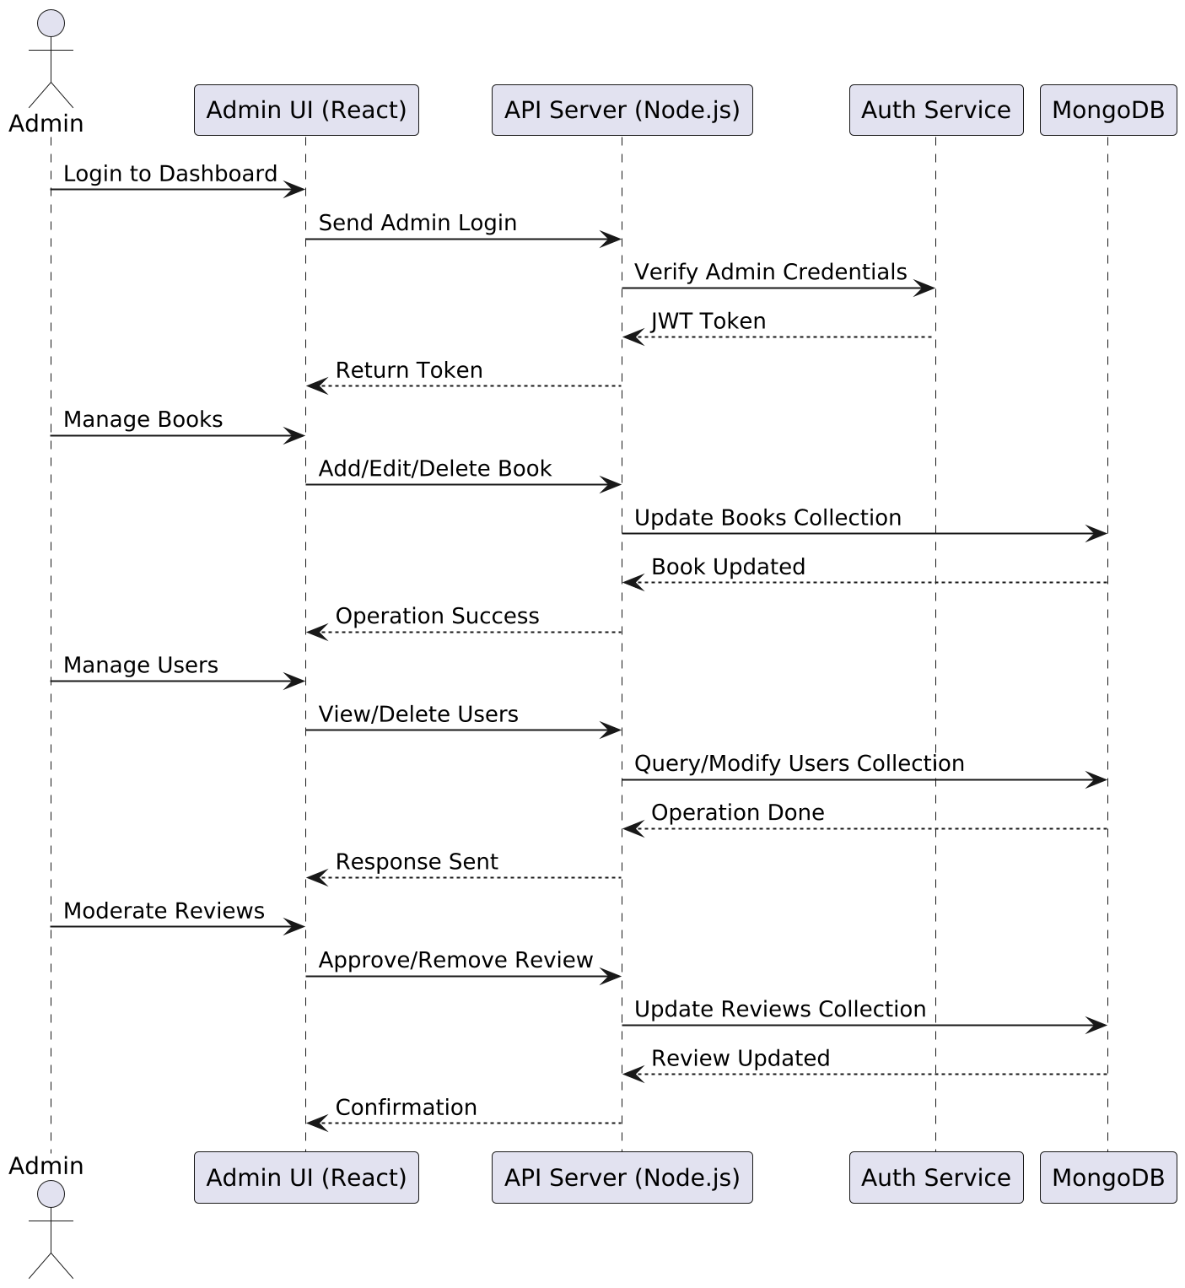
modeling:
Sequence diagram of admin:-

Slide 21
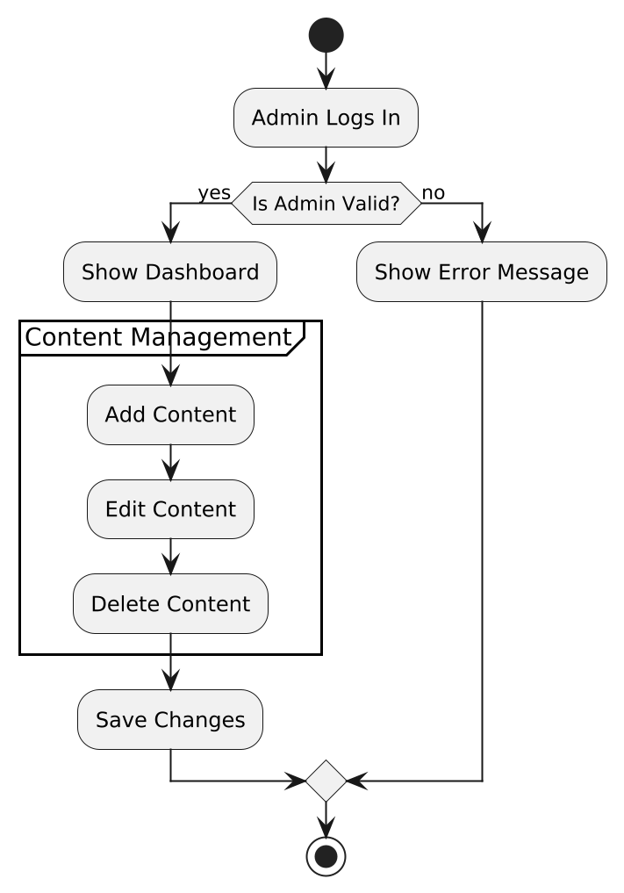
modeling:
Activity diagram:-

Slide 22
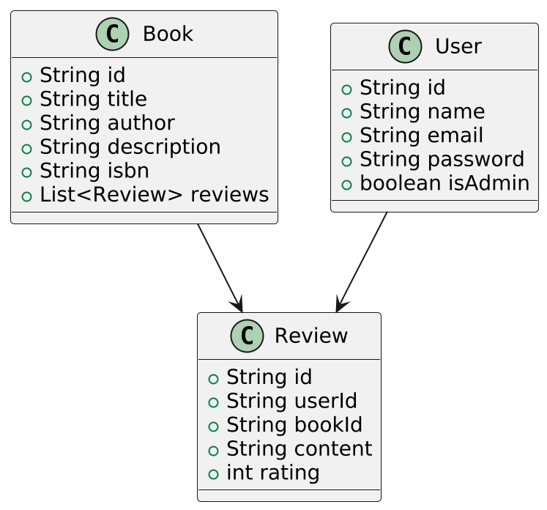
modeling:
Class diagram:-

Slide 23
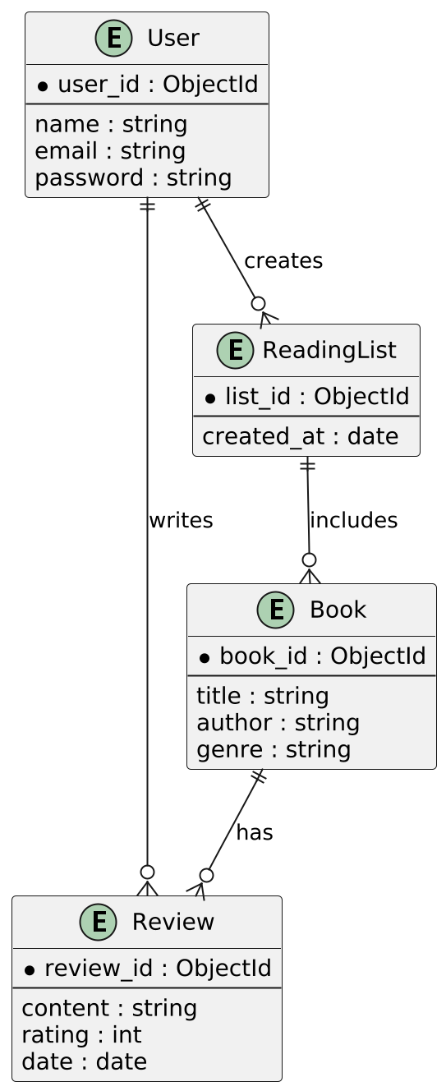
modeling:
ER diagram:-

Slide 24
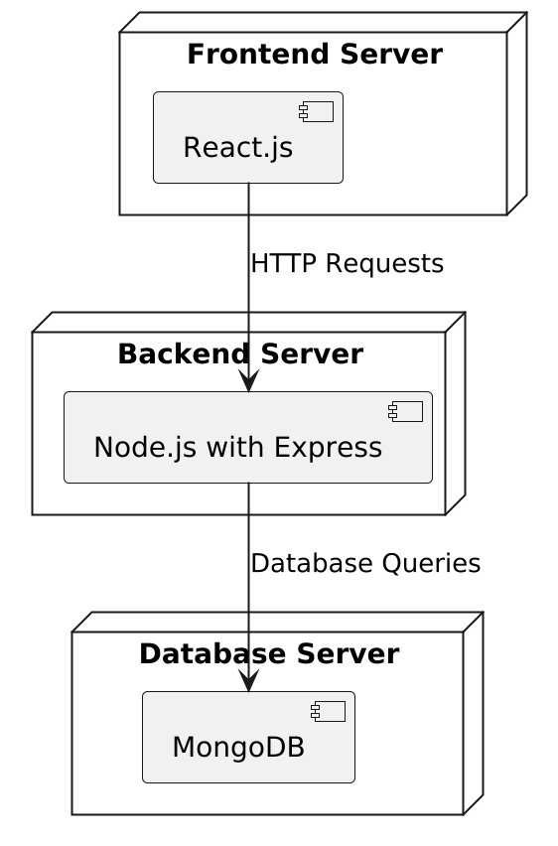
modeling:
Deployment diagram:-

Slide 25
Testing:
Black Box Testing:
User registration flow
Book management operations
Review submission process
Reading list functionality
White Box Testing:
Authentication logic
Data filtering and sorting
API endpoint validation
Database operations

Slide 26
Testing:
Manual Testing:
UI/UX validation
Cross-browser compatibility
Mobile responsiveness
Error handling
Performance and Load Testing:
Response time measurement
Concurrent user handling
Database query optimization
Memory usage monitoring

Slide 27
Results and challenges:
Results Achieved
Successful implementation of:
Dual role system
Book management
Review system
Reading list features
Performance metrics:
Fast page load times
Efficient data handling
Responsive design
Secure authentication
Challenges Encountered:
Technical Challenges:
Session management
Real-time updates
Image handling
Data validation
Implementation Challenges:
Complex state management
Role-based access control
API security
Data consistency

Slide 28
conclusion:
Conclusions and Limitations
Successfully implemented:
Modern book review platform
Comprehensive admin controls
User-friendly interface
Secure authentication
Limitations:
Single server deployment
Limited social features
Basic search functionality
Scope for Future Work
Enhanced Features:
Advanced search
Social interactions
Reading analytics
Book recommendations
Technical Improvements:
Real-time notifications
Offline support
Performance optimization
Enhanced security

Slide 29
Bibliography:
React Documentation
Express.js Guide
MongoDB Manual
TypeScript Handbook
Tailwind CSS Documentation
React Query Documentation
Node.js Documentation

Slide 30
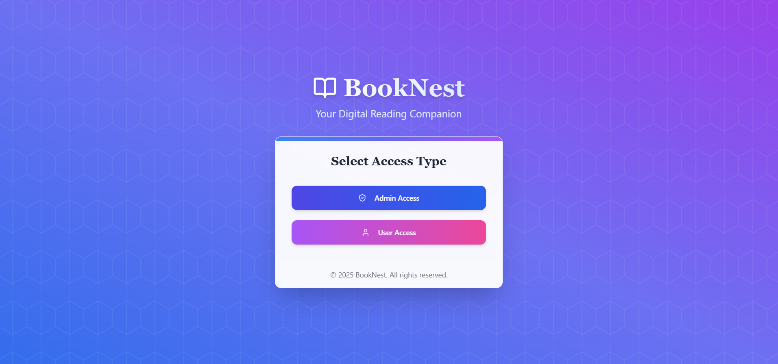
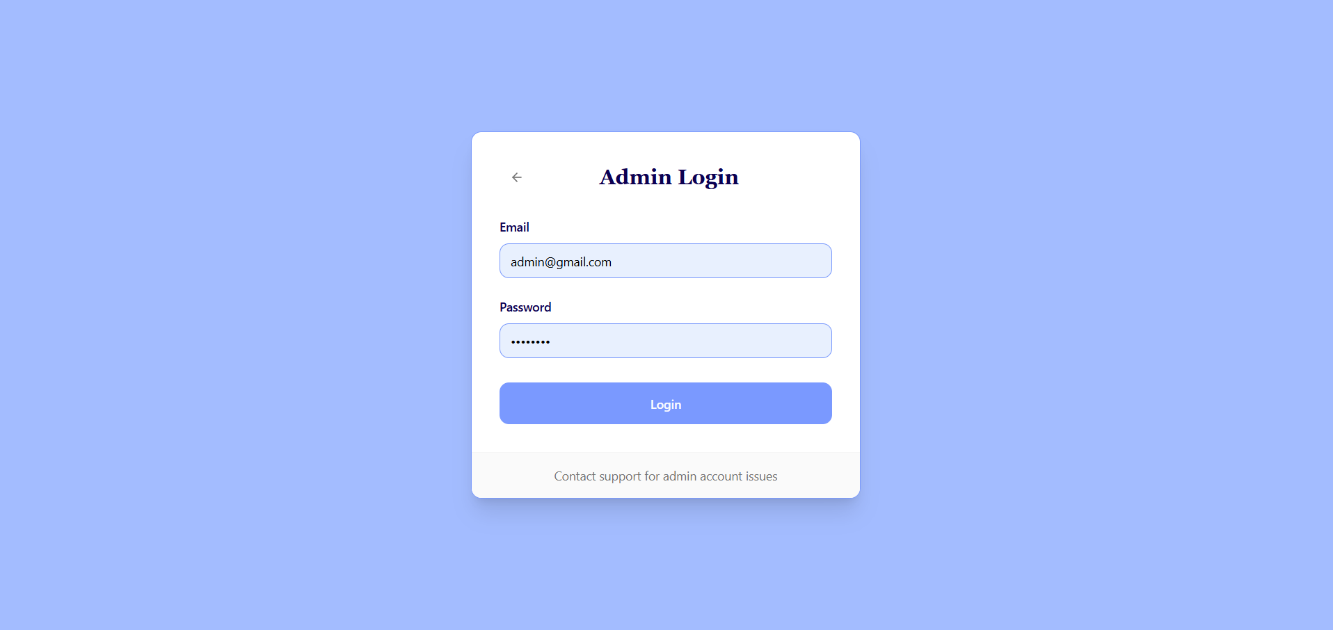
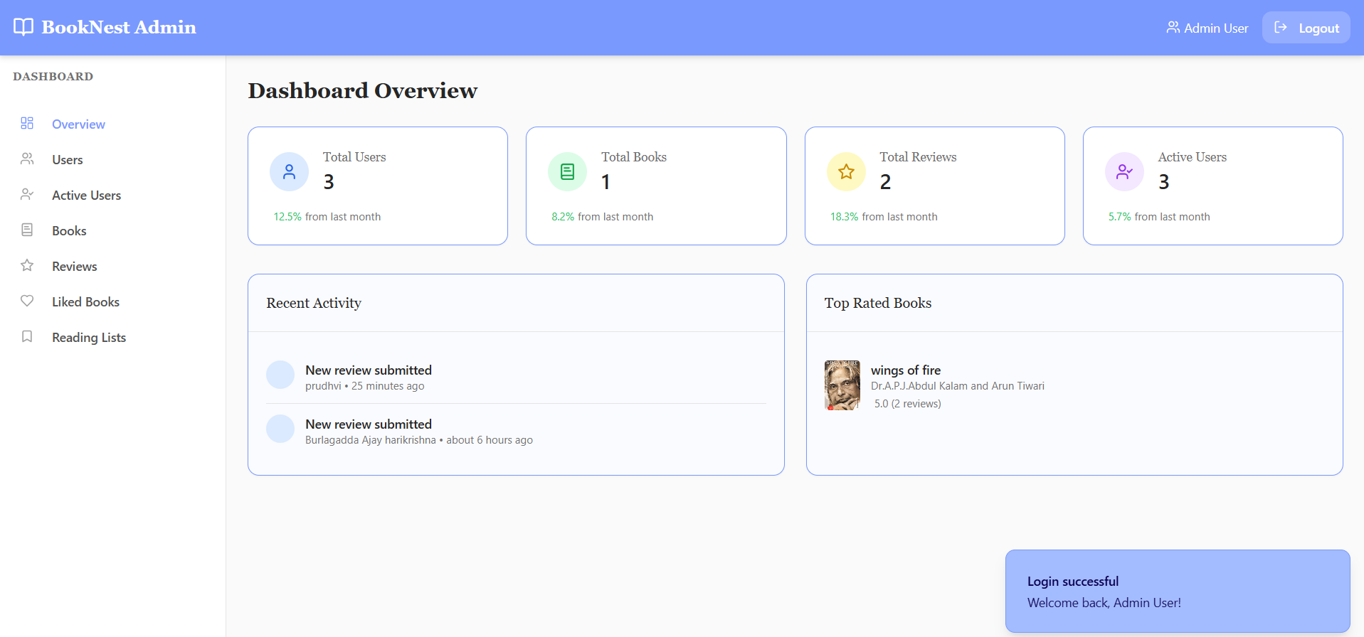
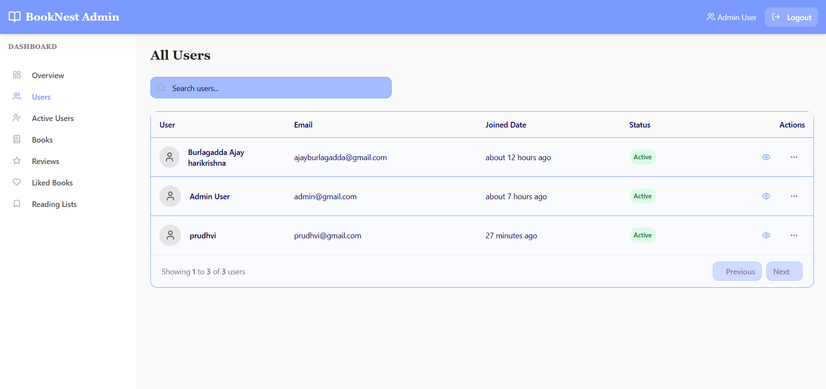
Outputs:-

Slide 31
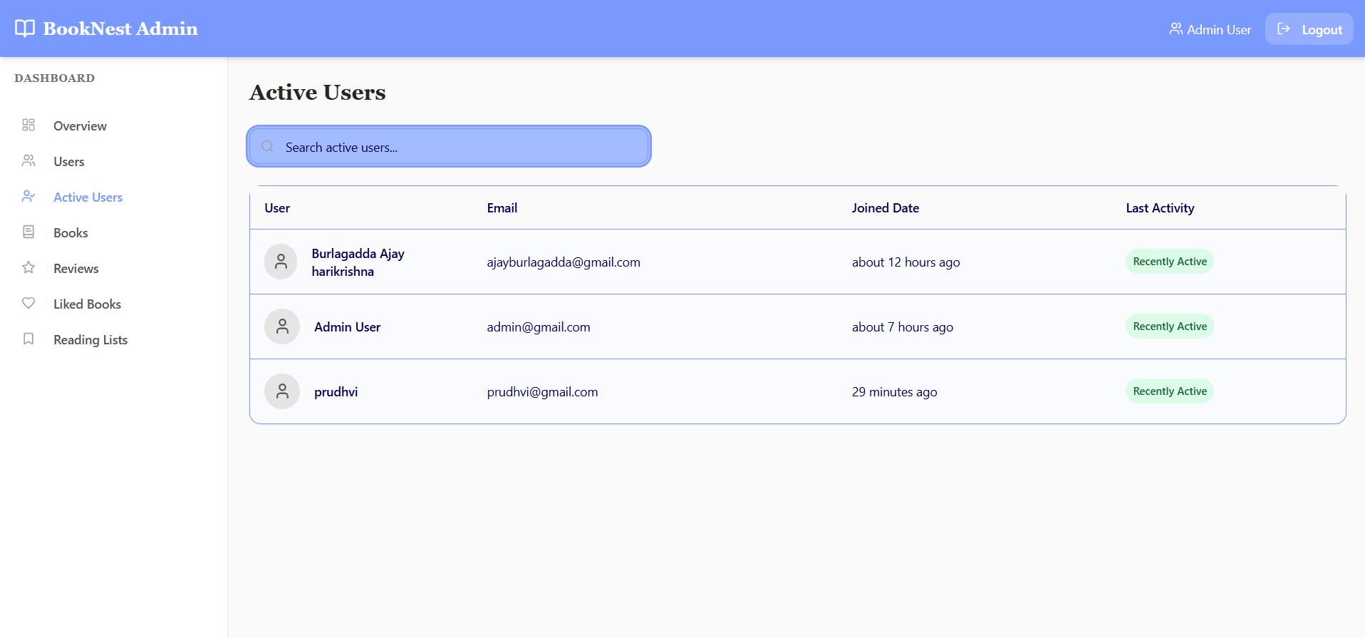
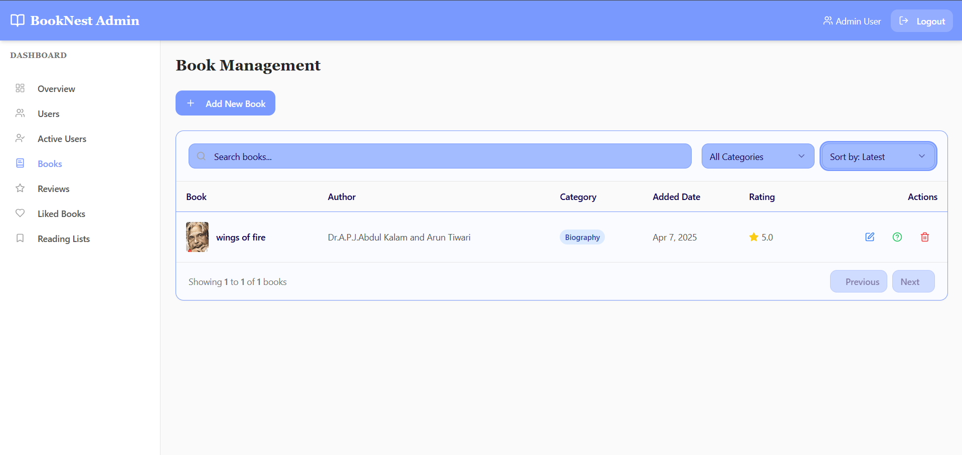
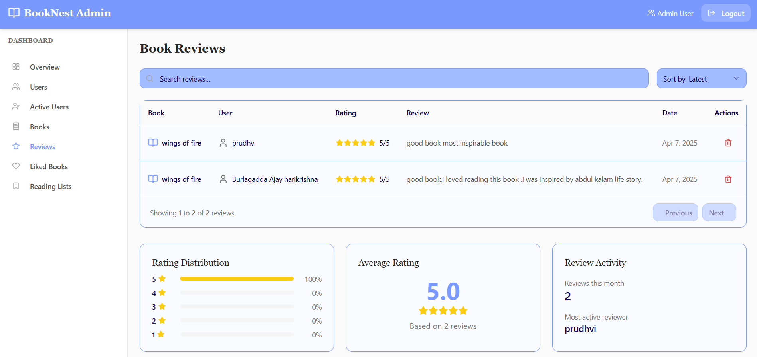
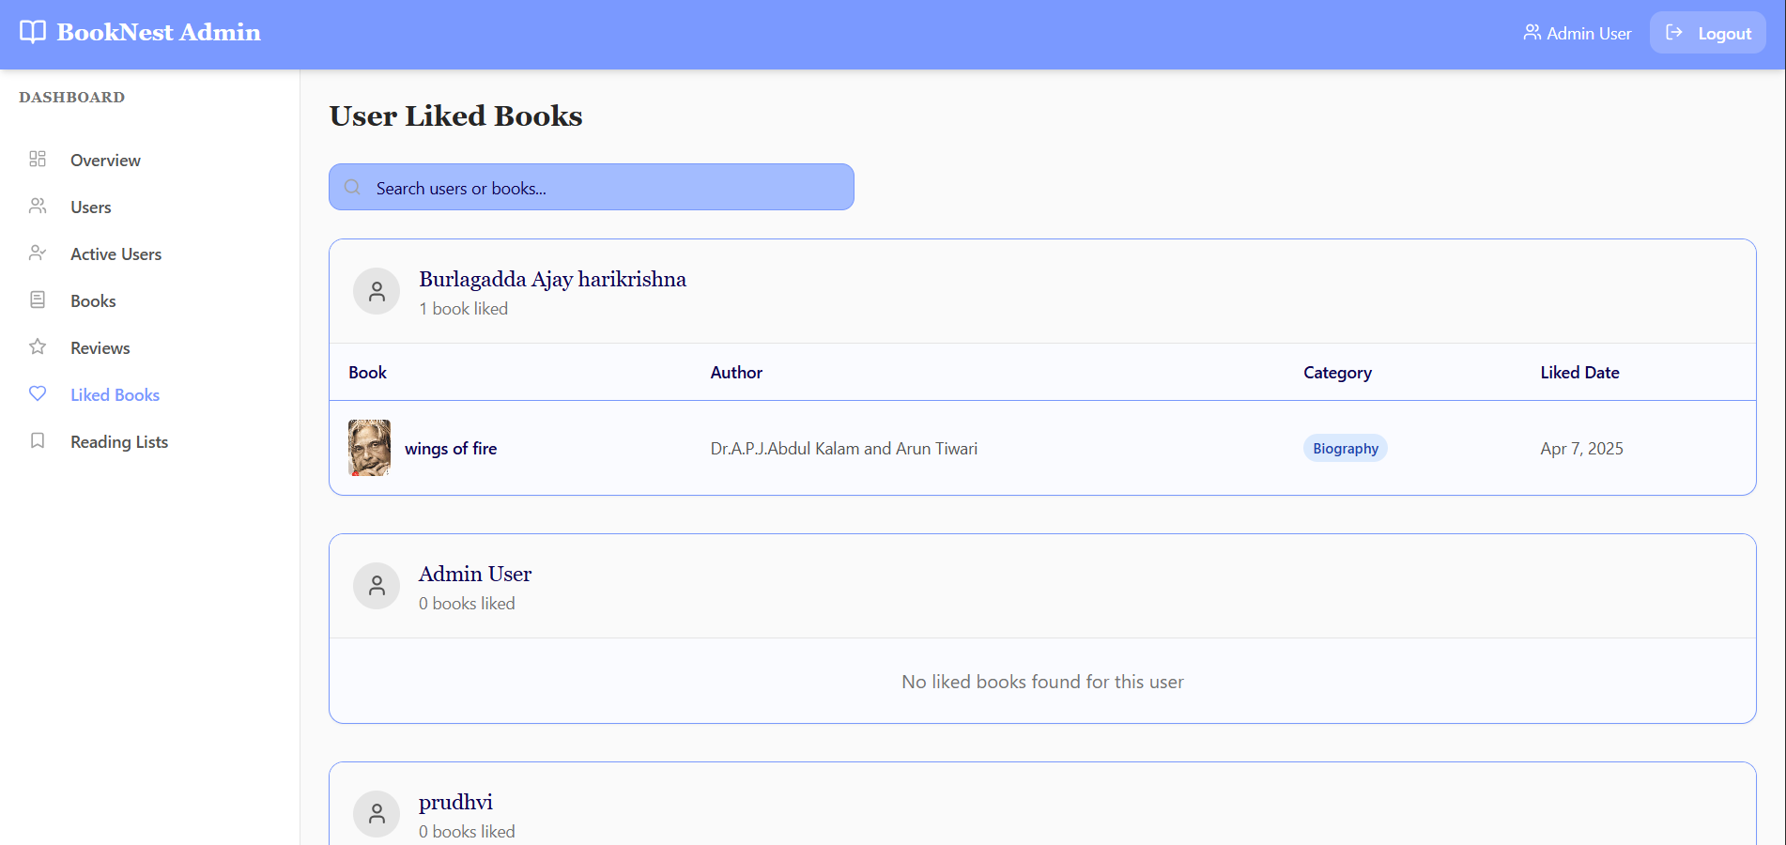

Slide 32
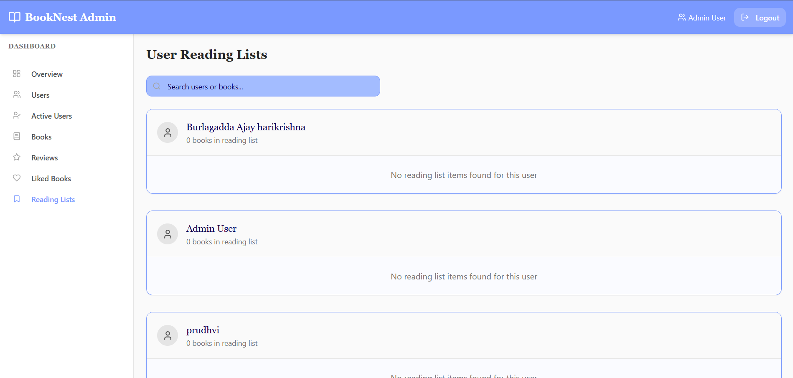
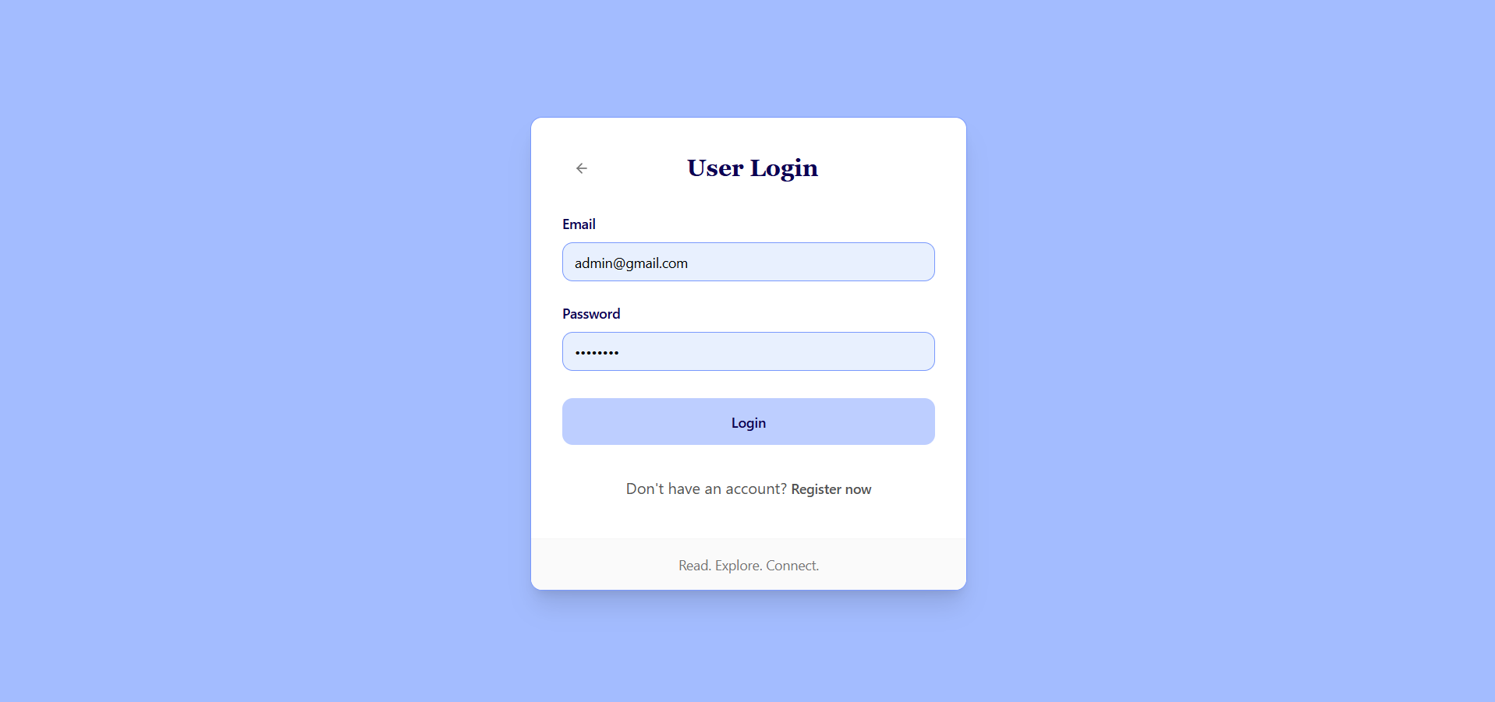
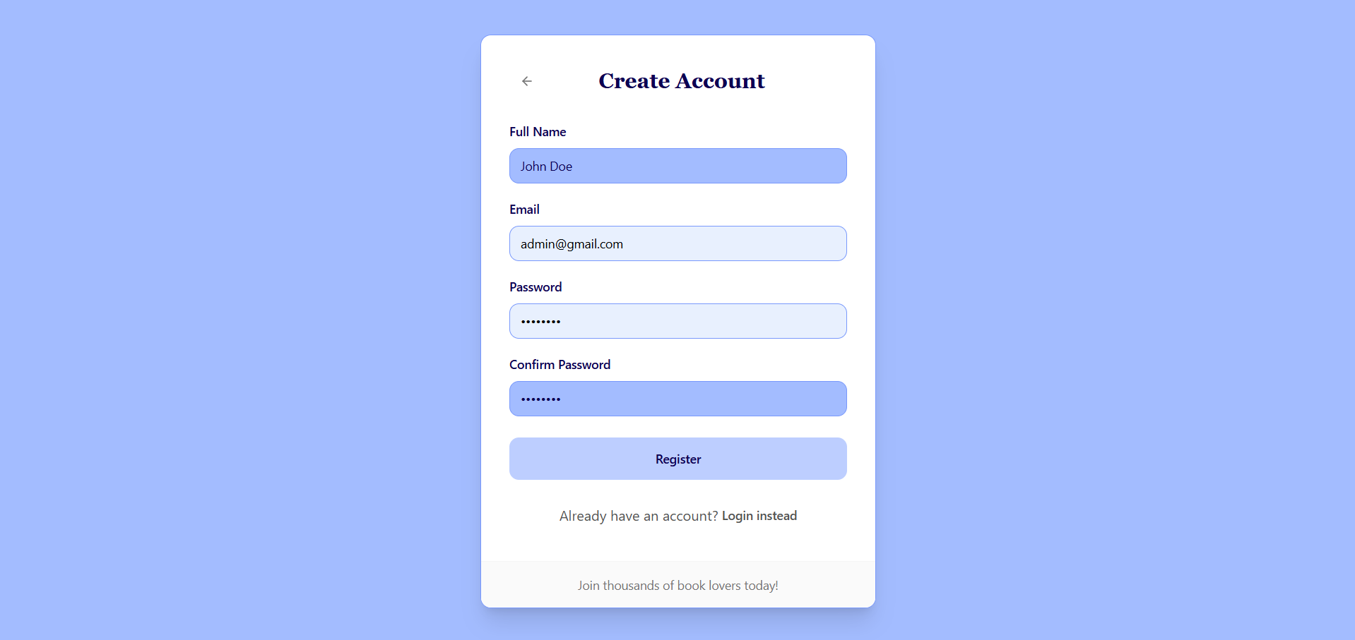
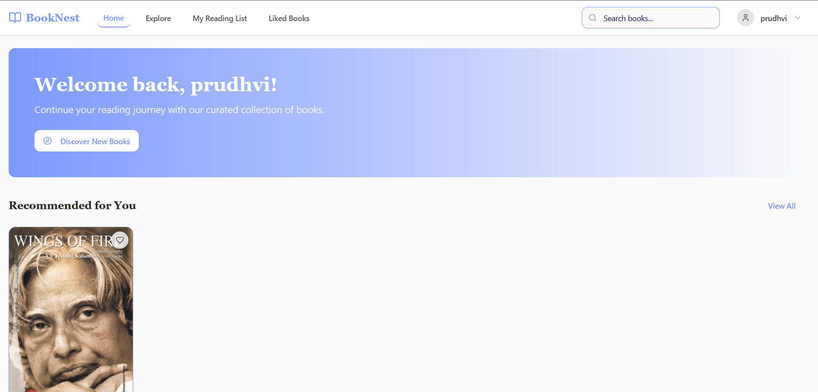

Slide 33
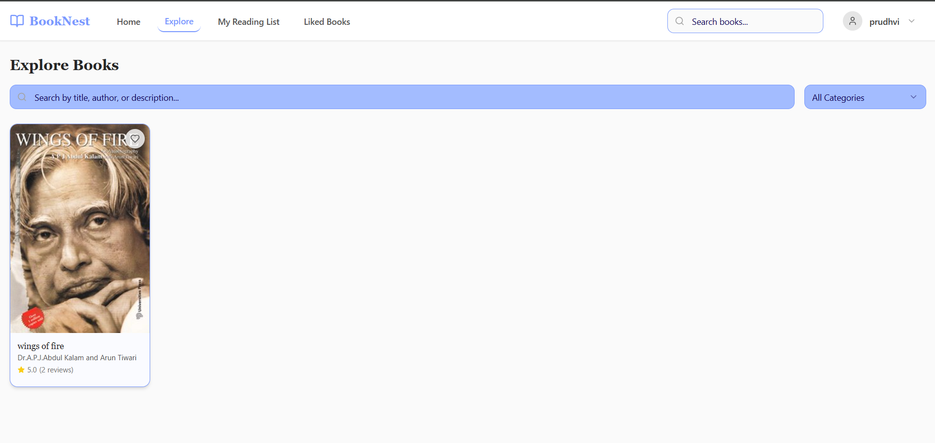
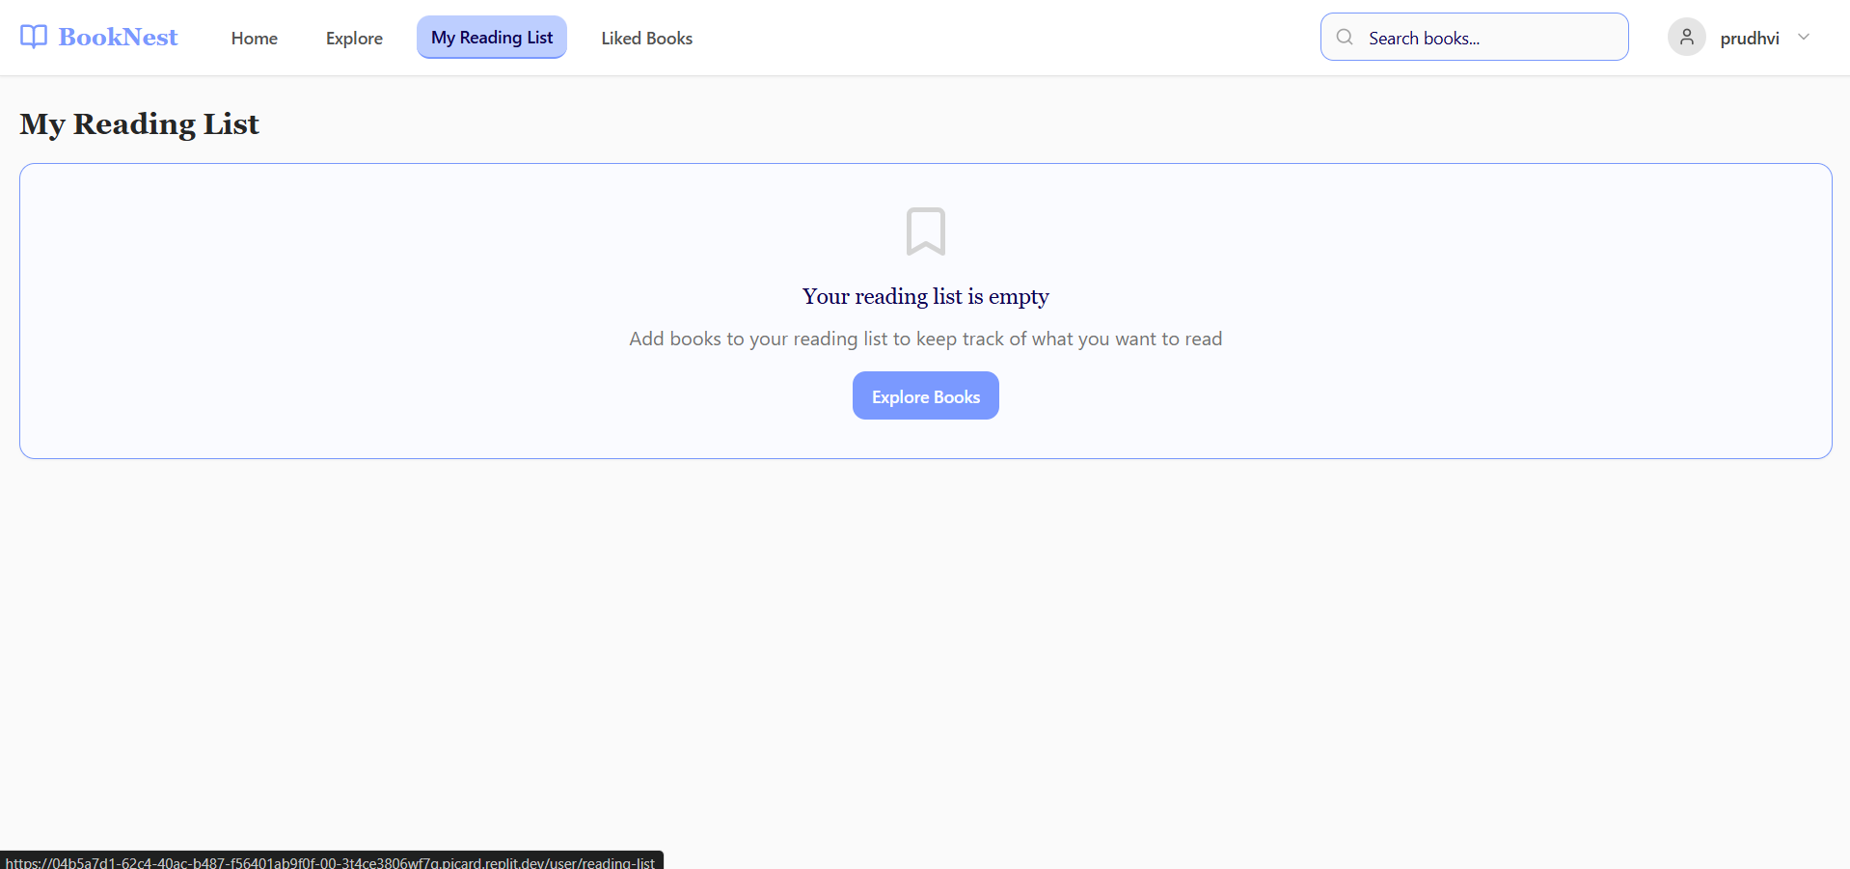
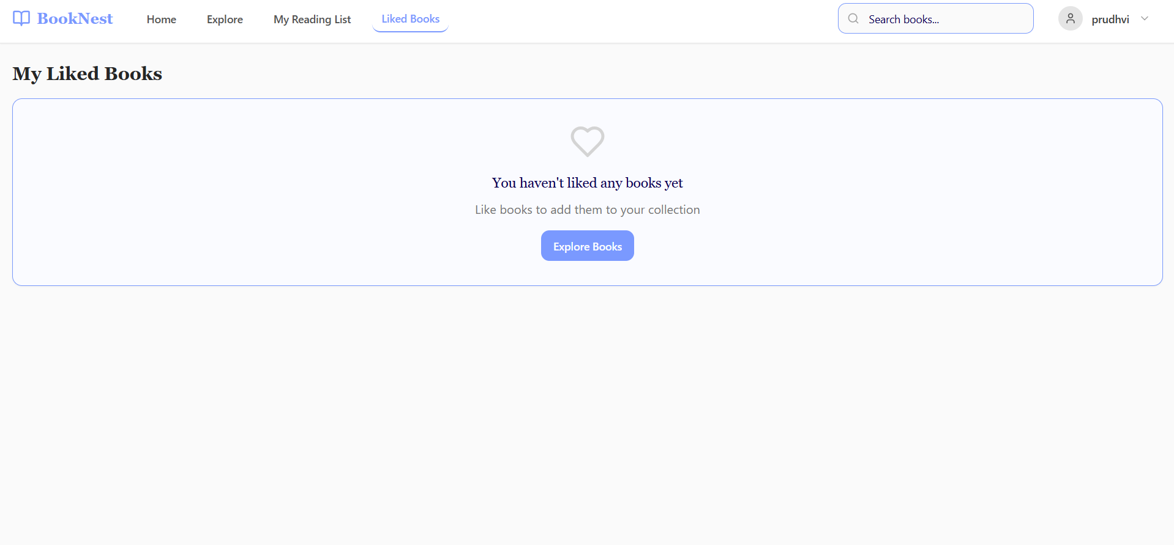
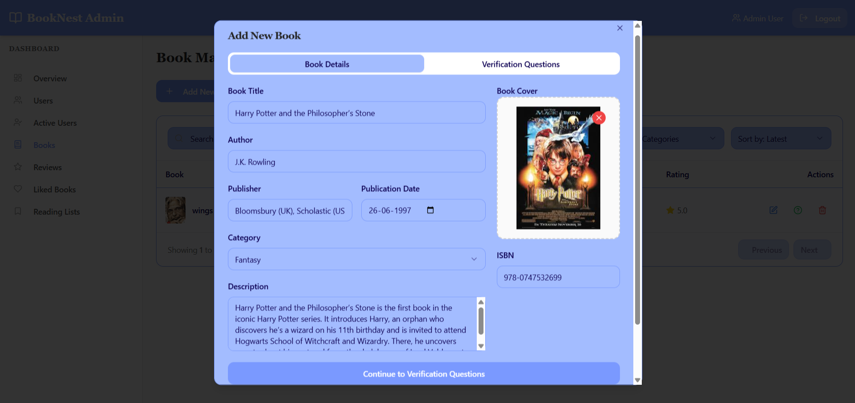

Slide 34
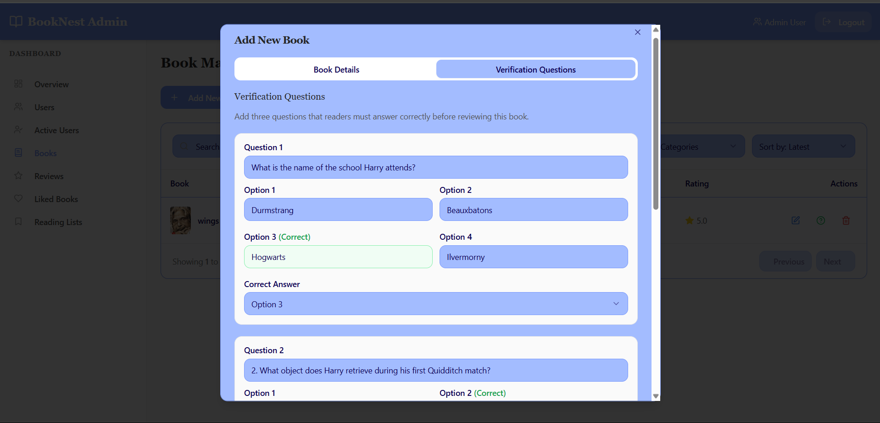
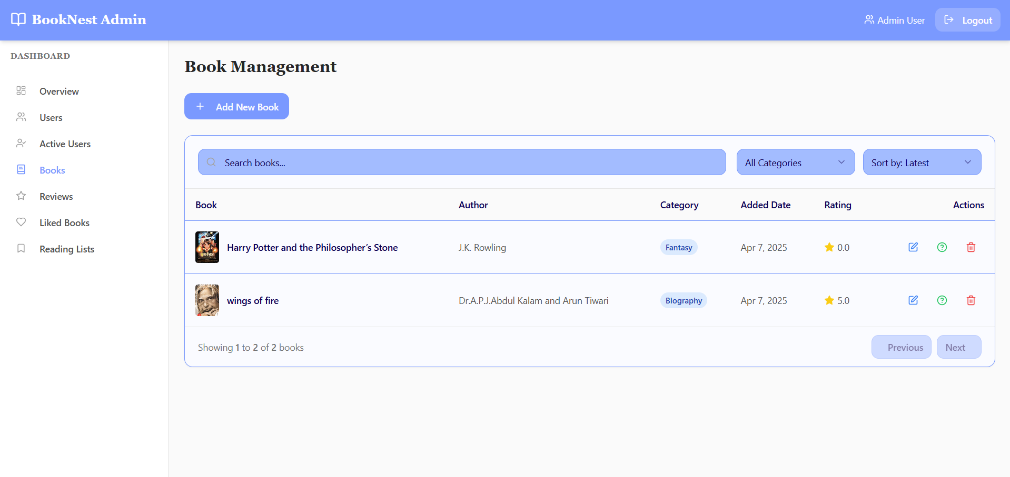

Slide 35
Thank you

